Slide 1
DIYALA UNIVERSITY COLLEGE OF ENGINEERING DEPARTMENT OF COMMUNICATIONS ENGINEERING
Mathematics- II
$$4^{th }Lecture$$
First Year
lecturer
Wisam Hayder
2021

Slide 2
Graphical Solutions of Autonomous Equations
The starting ideas for a graphical solution are the notions of phase line and equilibrium value.
Equilibrium Values and Phase Lines

Slide 3
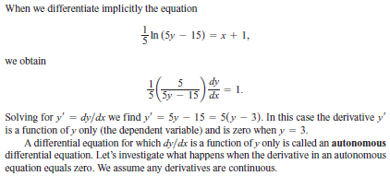
Graphical Solutions of Autonomous Equations
Thus, equilibrium values are those at which no change occurs in the dependent variable, so y is at rest.
The emphasis is on the value of y where dy /dx=0 $,$not the value of x,

Slide 4
Graphical Solutions of Autonomous Equations
$For example, the equilibrium values for the autonomous$
$differential equation$ are y= -1 and y=2.
To construct a graphical solution to an autonomous
differential equation, we first make a phase line for the
equation, a plot on the y-axis that shows the equation’s
equilibrium values along with the intervals where dy/ dx
and ${d^{2}y}/{{dx}^{2}}$are positive and negative.

Slide 5
Graphical Solutions of Autonomous Equations
$Then we know where the solutions are increasing and$
$decreasing, and the concavity of the solution curves.$
Example 1 Draw a phase line for the equation and use it to
sketch solutions to the equation.

Slide 6
Graphical Solutions of Autonomous Equations

Slide 7
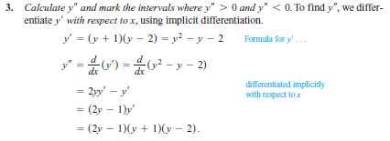
Graphical Solutions of Autonomous Equations

Slide 8
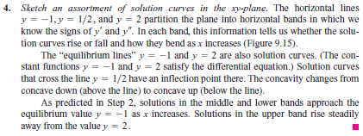
Graphical Solutions of Autonomous Equations
Notes:
aaa

Slide 9
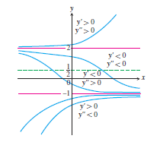
Graphical Solutions of Autonomous Equations
FIGURE 9.15 Graphical solutions from Example 1 include the horizontal lines y = -1 and y = 2 through the equilibrium values. No two solution curves can ever cross or touch each other.

Slide 10
Graphical Solutions of Autonomous Equations
Stable and Unstable Equilibria
Look at Figure 9.15 once more, in particular at the behavior of the solution curves near the equilibrium values.
Once a solution curve has a value near y = -1, it tends steadily toward that value; y = -1 is a stable equilibrium.
Notes:
aaa

Slide 11
Graphical Solutions of Autonomous Equations
The behavior near y =2 is just the opposite: all solutions except the equilibrium solution y = 2, itself move away from it as x increases.
We call an unstable equilibrium.
If the solution is at that value, it stays, but if it is off by any amount, no matter how small, it moves away. (Sometimes an equilibrium value is unstable because a solution moves away from it only on one side of the point.)
Notes:
aaa

Slide 12
Graphical Solutions of Autonomous Equations
Newton’s Law of Cooling
Modeling Newton’s law of cooling.
Here H is the temperature of an object at time t and $H_{s}$ is the constant temperature of the surrounding medium.
Suppose that the surrounding medium (say a room in a house) has a constant Celsius temperature of 15°C.

Slide 13
Graphical Solutions of Autonomous Equations
We can then express the difference in temperature as $H_{(t)} −15$.
Assuming H is a differentiable function of time t, by Newton’s law of cooling, there is a constant of proportionality k>0 such that
(minus k to give a negative derivative when H > 15).

Slide 14
Graphical Solutions of Autonomous Equations
Notes:
aaa

Slide 15
Graphical Solutions of Autonomous Equations
Notes:
aaa

Slide 16
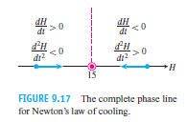
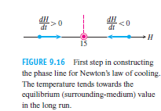
Graphical Solutions of Autonomous Equations
Notes:
aaa

Slide 17
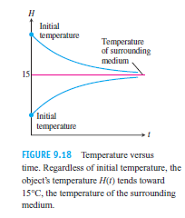
Graphical Solutions of Autonomous Equations
Notes:
aaa

Slide 18
Graphical Solutions of Autonomous Equations
Logistic Population Growth
(5) model of exponential change for population growth
Where k > 0 is the birth rate minus the death rate per individual per unit time.
, maximum population M, growth rate k
where r > 0 is a constant.
Notice that k decreases as P increases toward M and that k is negative
if P is greater than M.
Substituting r(M- P) for k in Equation (5) gives the differential equation

Slide 19
Graphical Solutions of Autonomous Equations
(6)
The above model is referred to as logistic growth.

Slide 20
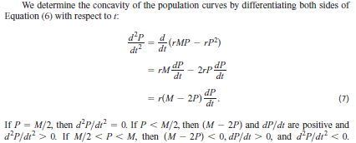
Graphical Solutions of Autonomous Equations

Slide 21
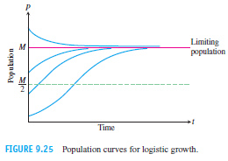
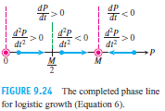
Graphical Solutions of Autonomous Equations

Slide 22
Systems of Equations and Phase Planes
A Competitive-Hunter Model
Imagine two species of fish, say trout and bass, competing for the same limited resources (such as food and oxygen) in a certain pond.
We let x(t) represent the number of trout and y(t) the number of bass living in the pond at time t.
In reality x(t) and y(t) are always integer valued, but we will approximate them with real-valued differentiable functions. This allows us to apply the methods of differential equations.

Slide 23
Systems of Equations and Phase Planes
A large number of bass tends to cause a decrease in the number of trout, and vice-versa.
Our model takes the size of this effect to be proportional to the frequency with which the two species interact, which in turn is proportional to xy , the product of the two populations.
These considerations lead to the following model for the growth of the trout and bass in the pond:

Slide 24
Systems of Equations and Phase Planes
Here x(t) represents the trout population, y(t) the bass population, and a, b, m, n are positive constants.
A solution of this system then consists of a pair of functions x(t) and y(t) that gives the population of each fish species at time t.
Each equation in (1) contains both of the unknown functions x and y, so we are unable to solve them individually. Instead, we will use a graphical analysis to study the solution trajectories of this competitive-hunter model.
We now examine the nature of the phase plane in the trout-bass population model.

Slide 25
Systems of Equations and Phase Planes
We will be interested in the 1st quadrant of the xy- plane, where x$≥0$ and y $≥$0 since populations cannot be negative.
First, we determine where the bass and trout populations are both constant. Noting that the x(t) and y(t) values remain unchanged when ${dx}/{dt=0}$ and ${dy}/{dt=0}$ , Equations (1a and 1b) then become
This pair of simultaneous equations has two solutions(x,y)=(0,0) and (x,y)= ($m/{n, }$ $a/b$). At these (x, y) values, called equilibrium or rest points, the two populations remain at constant values over all time.

Slide 26
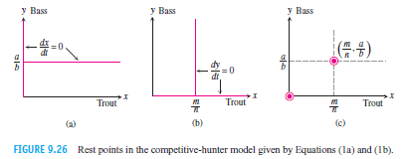
Systems of Equations and Phase Planes

Slide 27
Systems of Equations and Phase Planes

Slide 28
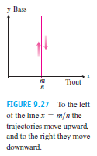
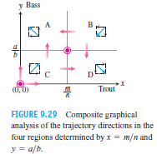
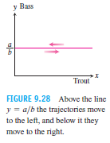
Systems of Equations and Phase Planes

Slide 29
Systems of Equations and Phase Planes

Slide 30
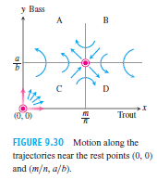
Systems of Equations and Phase Planes

Slide 31
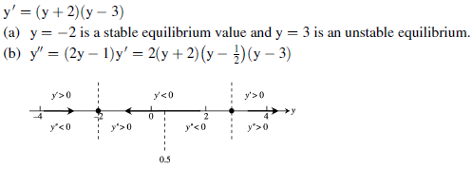
Ex 1. a. Identify the equilibrium values. Which are stable and which
are unstable?
b. Construct a phase line. Identify the signs of and
c. Sketch several solution curves.
$$1. \frac{dy}{dx}=(y+2)(y−3)$$
Sol.

Slide 32
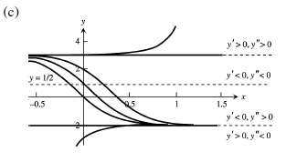

Slide 33
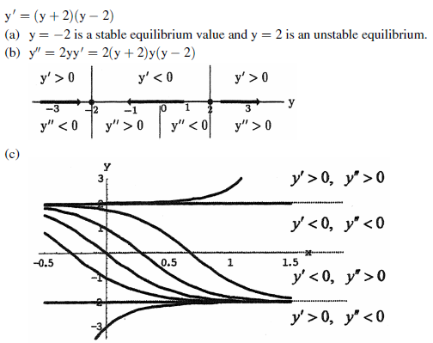
$$2. \frac{dy}{dx}= y^{2}−4$$
Sol.

Slide 34
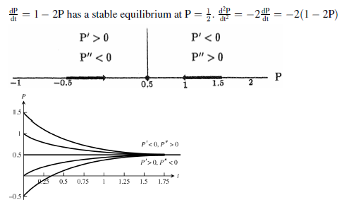
Ex 2. The autonomous differential equations represent models for population growth. Use a phase line analysis to sketch solution curves for P(t), selecting different starting values P(0). Which equilibria are stable, and which are unstable?
Sol.

